Slide 1


NCC
Members: .
0136283 Darren Barker .
0131228 Lee Peng Chung.
0125960 Timothy Chong
0135796 Tan Chung Kun
0132867 Brendon Wei .
0135933 Lau Jaw Cherng.
0135760 Joshua Yeoh
Malaysia

Slide 2


Story Narrative

Slide 3

Game Setting
The game is set during XX XXXX in a highly secretive and technologically advanced facility located deep in the heart of Malaysia’s densest jungle. Known as the Nexus Containment Center (NCC), this facility is dedicated to securing, containing, and protecting supernatural entities native to Malaysian folklore. The NCC is built over a nexus of ley lines, powerful spots of magical energy, which attract these entities and enhance their powers.

Slide 4

Backstory
For centuries, the creatures of South East Asia folklore roamed freely among humans, often causing havoc and fear. As the modern era approached, a covert government agency known as the Midnight Wardens was formed to control these supernatural beings and protect the human realm. The Nexus Containment Centre (NCC) was established as a prison and research facility to hold these mysterious South East Asian creatures.

Slide 5

The Player & The Plot
You play as a new recruit, who has just been assigned her first night shift at the NCC. Your primary role is to monitor the containment units and ensure none of the supernatural inmates escape. On your first night, a mysterious and powerful storm disrupts the facility’s power grid, releasing electromagnetic pulses that intermittently disable the security locks. You can even call for the specific exorcists to deal with the specific monsters.
As the night progresses, it becomes apparent that the storm is no natural phenomenon but a magical disturbance possibly orchestrated from within the facility. With limited access to the central control systems and armed only with a high-tech tablet that can access CCTV, control doors, and interact with other technology, the player must navigate the dimly lit corridors filled with creeping mists and strange echoes.

Slide 6
Gameplay & Mechanics
Survival Horror
Players must fend themselves from the various supernatural creatures to survive the night. The facility contains many, different creatures, and the players need to quickly identify them and react appropriately to survive their onslaughts.
Interaction with Entities
Players can interact with some of the creatures. Some entities might provide hints or assistance if approached correctly, reflecting the complex nature of the beings held within the NCC.

Slide 7
Game Objectives
Survive until the third day when backup can finally arrive, re-contain any escaped entities, and uncover the true cause of the storm within the Nexus Containment Center.

Slide 8
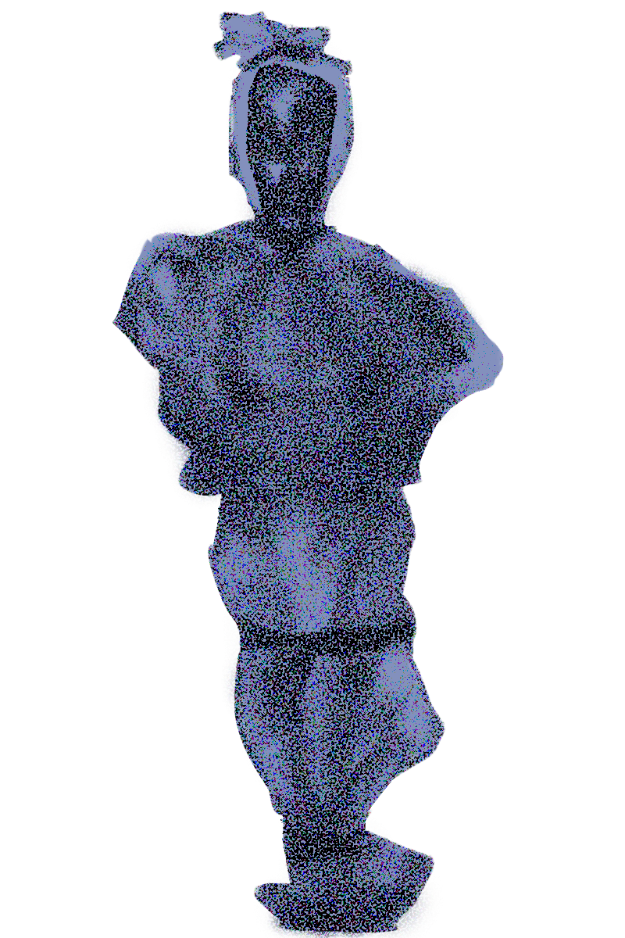

Theme

Slide 9
Theme
Interpretation : Oppression is done by the VICTOR
CHAOTIC Creatures invented by the +`@.,!?”#/

Slide 10

Intention

Slide 11
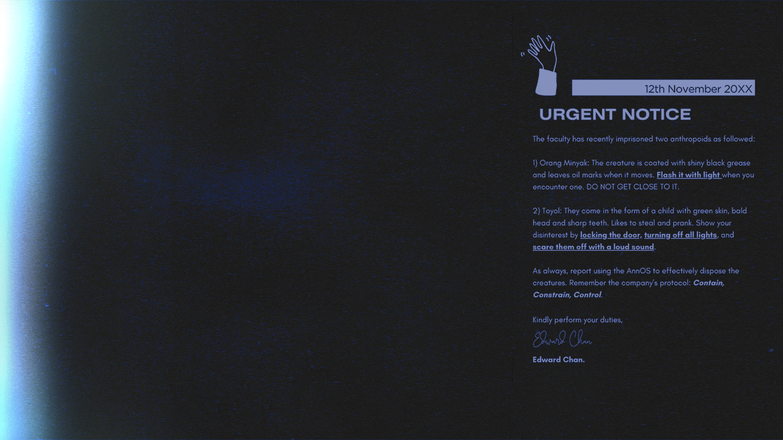
Intention 1. Telling Before Showing,
Toying Expectations
Tell players instructions of what they’ll encounter & how to act.
And then, show players what they've been dreading to challenge their assumptions.
Balance between knowing and not knowing through sight or sound (clues or sightings) and feedback (result of actions).
Filtered information through vaguely formal, objective or technical descriptors.
Player has to survive from 10am
to 6pm.

Slide 12
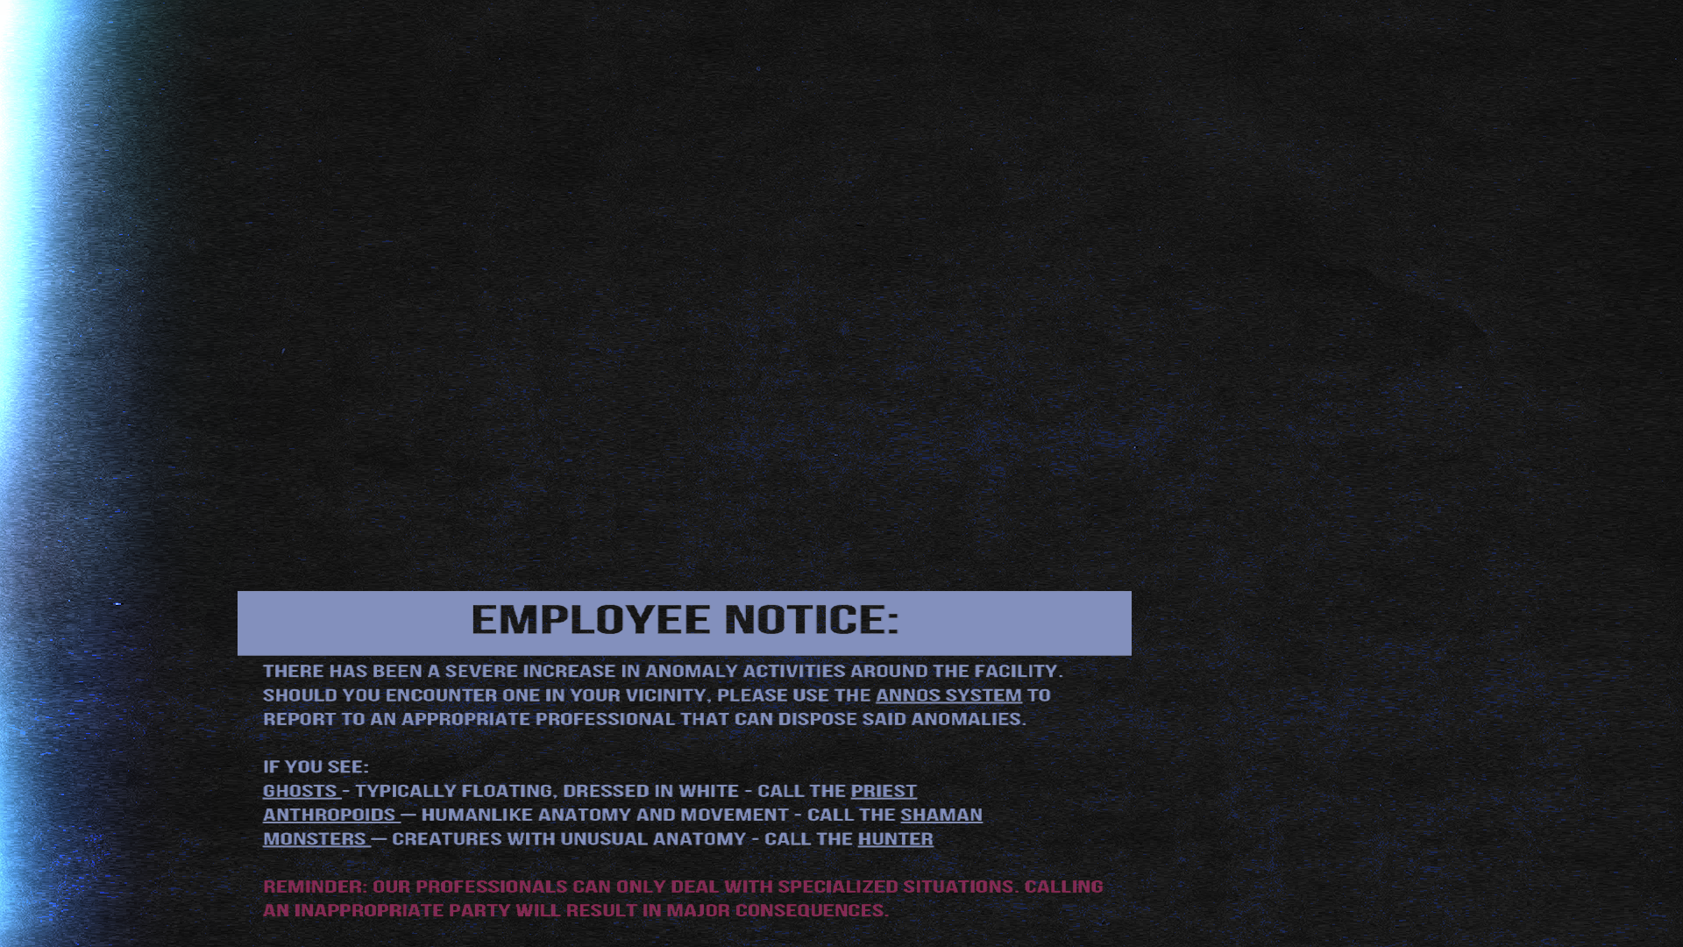
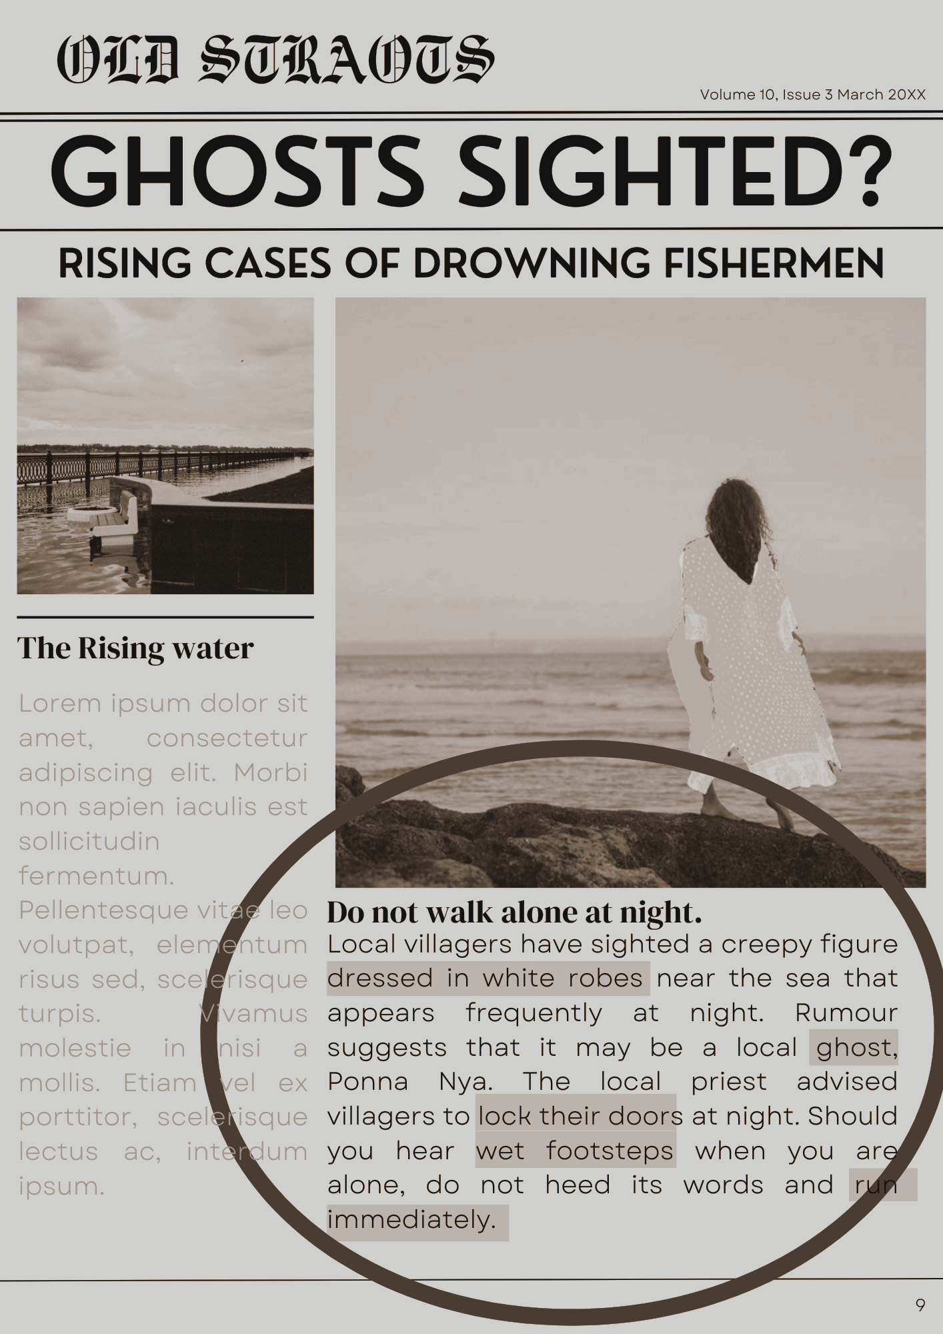
Intention 2. Grave Consequences
Calling "Specialists" to suppress a certain creature, nullify their anger/threat
If the player makes a wrong call, the specialist is killed and cannot be called upon again.
The game won’t end if the player makes the wrong call, it only makes the creature even more aggressive

Slide 13
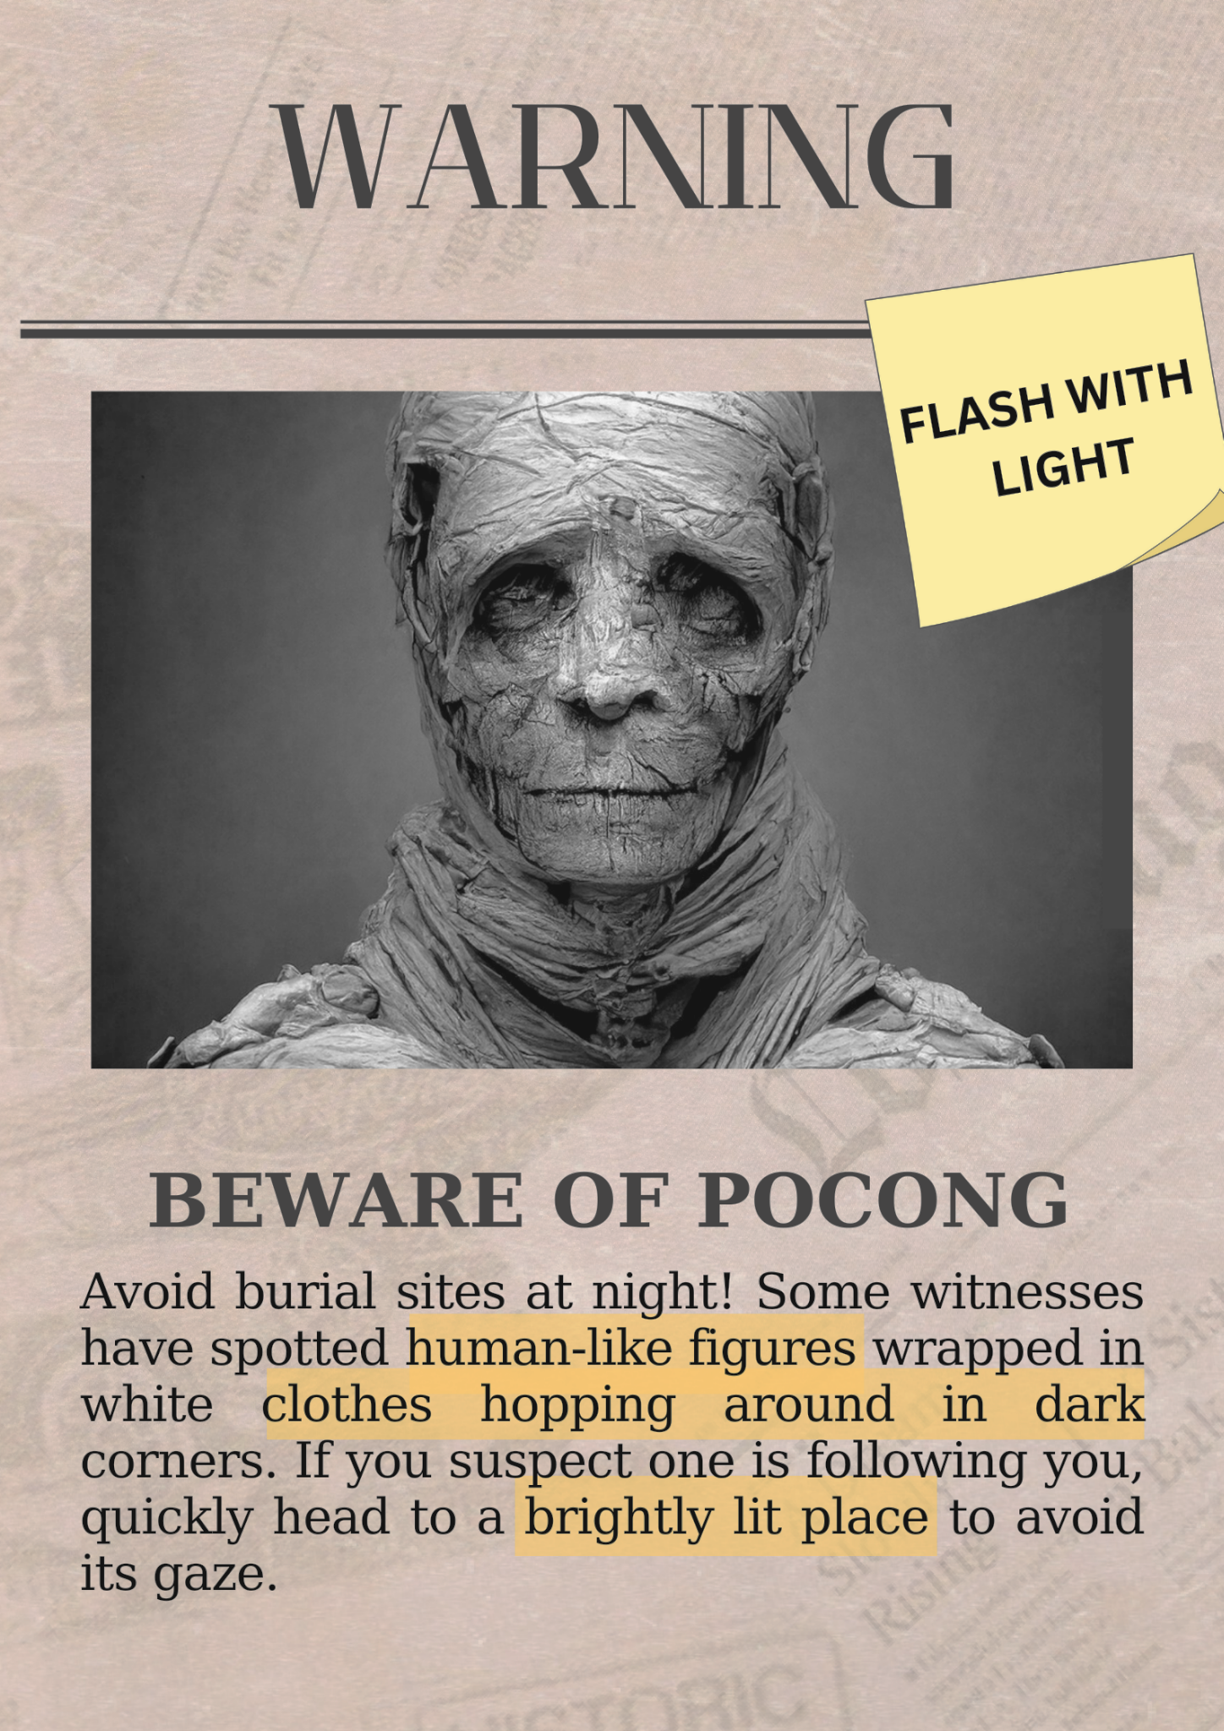
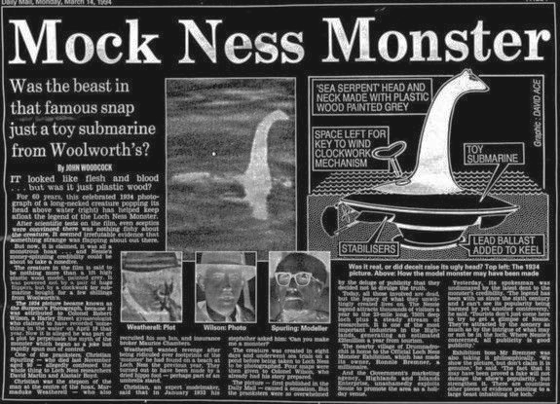
Intention 3. Types of Creatures
Some are hostile and aggressive, they are out to escape and/or kill the player
Some are neutral until provoked, becoming hostile in their own ways
Some creatures can provoke other creatures into becoming hostile
Your actions to placate a certain creature
can provoke another creature in turn.

Slide 14
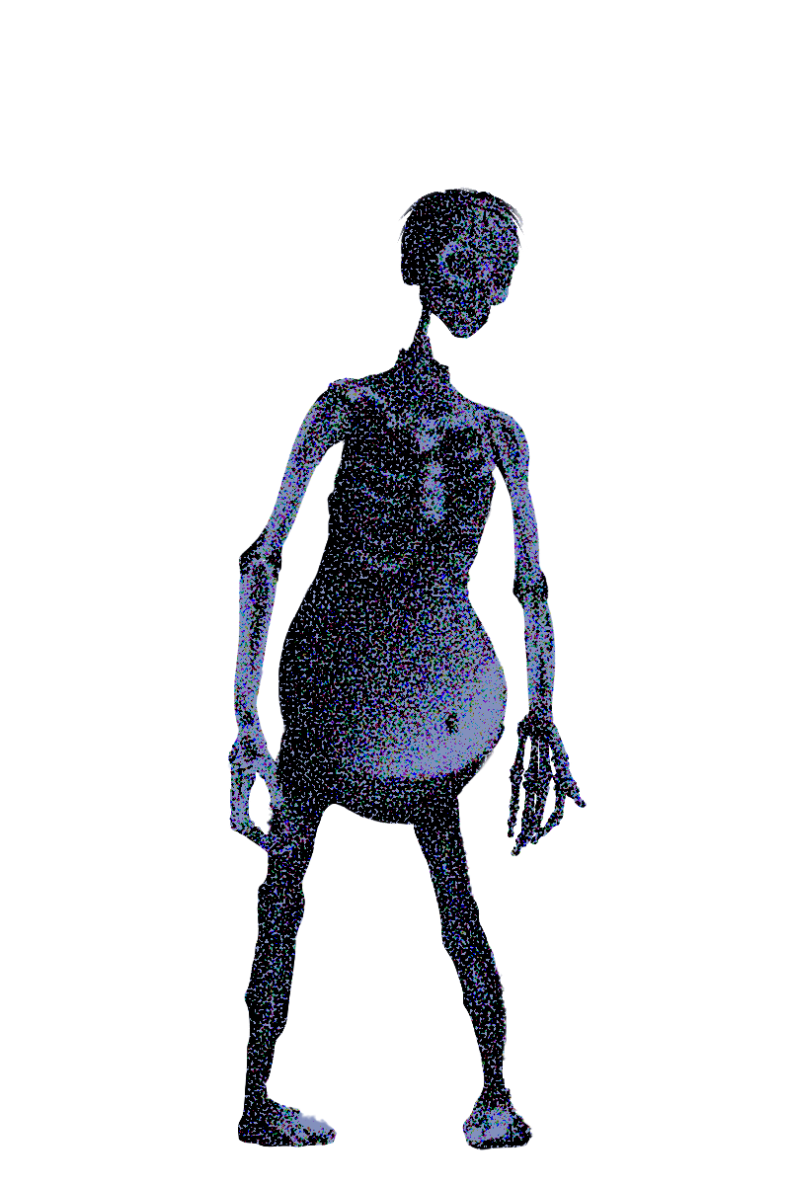
Desired Outcome

Slide 15
Desired Outcome 1. Telling Before Showing,
Toying Expectations
This creates a fear through uncertainty, the instructions are fresh on their mind but when time comes, they have to rely on their own judgement, how fast or sure can they make the distinction and act on it.
Tension is created through hyper-awareness, knowing something is about to happen but not knowing when.
They get a fright when something shows up different on the cameras (clues or sightings), starting the scramble to act. And the cycle repeats.
Plants a seed of suspicion against their superiors, is what they are doing ethically right or wrong.
Do THEY really CARE?
Do my actions MaTteR?

Slide 16
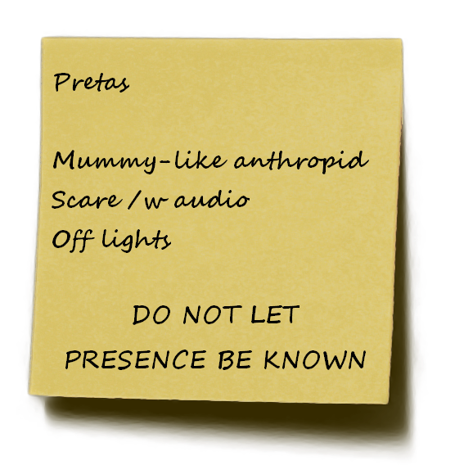
Desired Outcome 2. Grave Consequences
Makes their decision vital to survival. Players have to pay attention and consider their options. Can they gamble on their shots?
Human Resource management. Survival Horror. Player is gambling with human lives. Shadow Company bad. Reinforces theme of consequences.

Slide 17
Desired Outcome 3. Nature of Supernatural Creatures
Game becomes a chain reaction, ticking time bombs, reactive & volatile
Investigation, cause and effect, build up their knowledge of creature behaviour
Management, players have to juggle different creatures at a time, can they rely or risk it
Familiarity, cool yet scary
Sympathy?

Slide 18
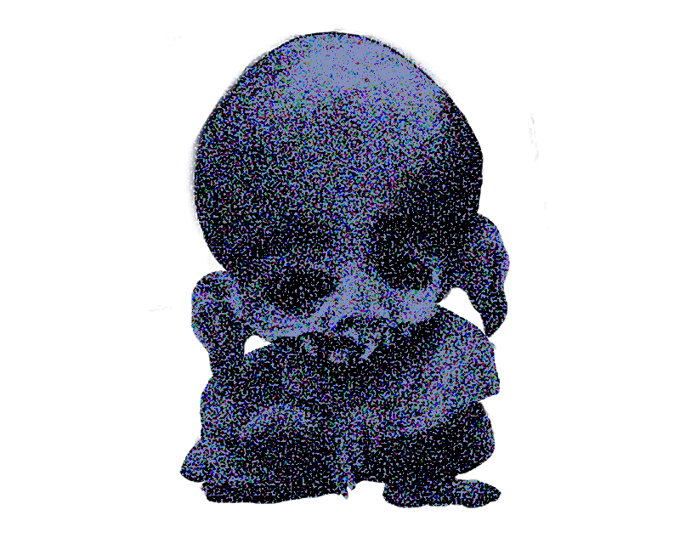

END OF TRANSMISSION

Slide 19
Insert Game Title TEXT text Text.,!?”*/
Insert Game Title TEXT text Text.,!?”*/
Insert Game Title TEXT text Text.,!?”*/
Insert Game Title TEXT text Text.,!?”*/
Insert Game Title TEXT text Text.,!?”*/
Insert Game Title TEXT text Text.,!?”*/
Insert Game Title TEXT text Text.,!?”*/
Insert Game Title TEXT text Text.,!?”*/
Insert Game Title TEXT text Text.,!?”*/

